Slide 1
Oil Spill Detection

Slide 2


Agenda
Introduction
Problem Statement
Data
Architectures
Methodology
Evaluation and Results
Conclusion

Slide 3
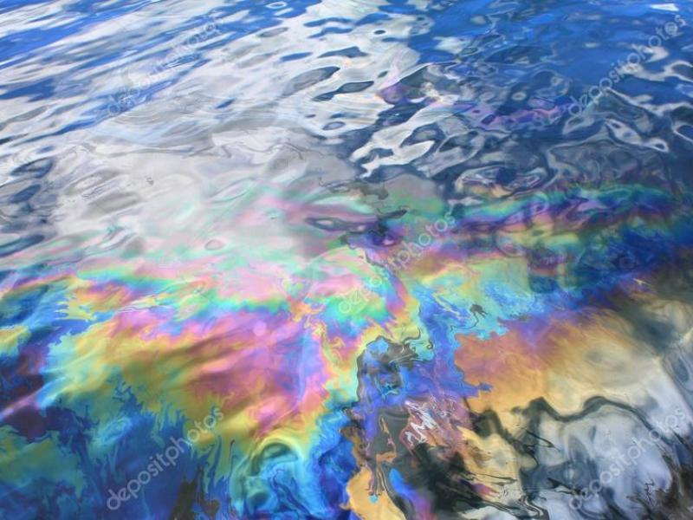
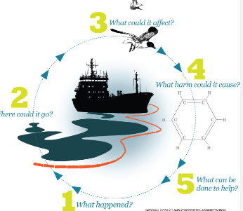
Oil Spill Cycle
This have devastating impacts on ecosystems, wildlife, and humans.
Can go anywhere that oil is spilled or released into the environment, including on land or in water.
harm or kill wildlife, and negatively affect the health of humans who come into contact
the release of crude oil or petroleum products into the environment
with measures such as regulations on oil drilling and transportation, technology to detect and prevent spills, and contingency plans to respond quickly in the event of a spill.

Slide 4
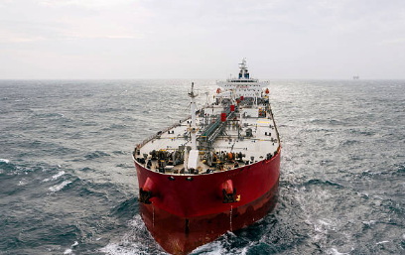
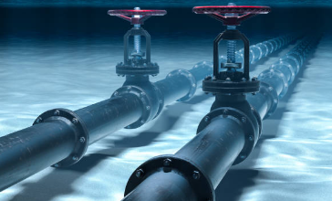
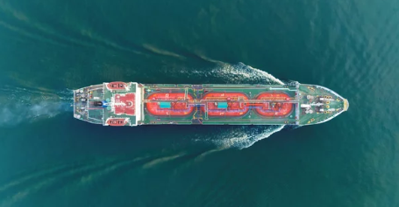
Means of Transport
Oil Tankers
Tanker vessels are categorized based on their regular operational routes over an extended period of time. These vessels typically continue to operate in the same trade, as changing a tanker's trade route requires significant effort and resources.
Pipelines
The transportation of oil through pipelines is crucial as a majority of the oil is transported through pipelines for a certain part of its journey. Once the crude oil is extracted from natural gas, pipelines are used to transport the oil to a refinery or to another mode of transportation.
LPG Tankers
Scientific progress has made it possible to convert natural gas into a liquid state at very low temperatures, which enables its transportation as liquefied natural gas (LNG). The vessels that transport LNG, known as LNG tankers, are constructed with two layers of hulls.

Slide 5
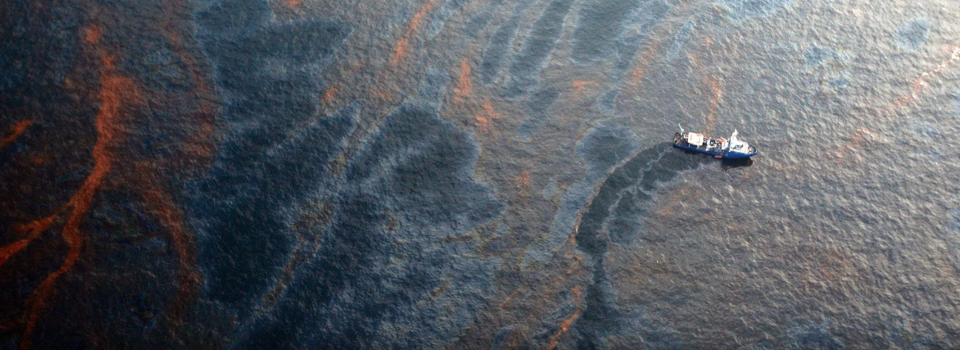
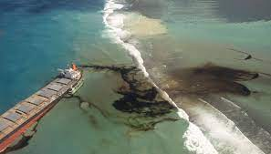
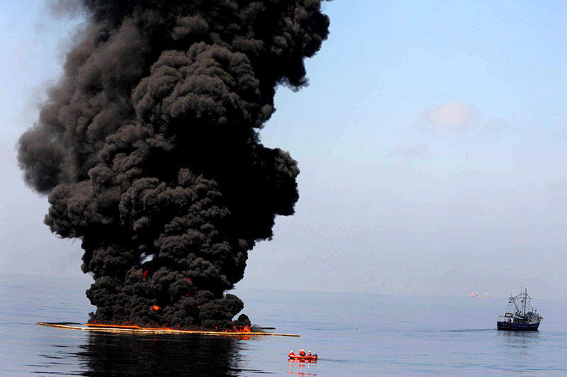
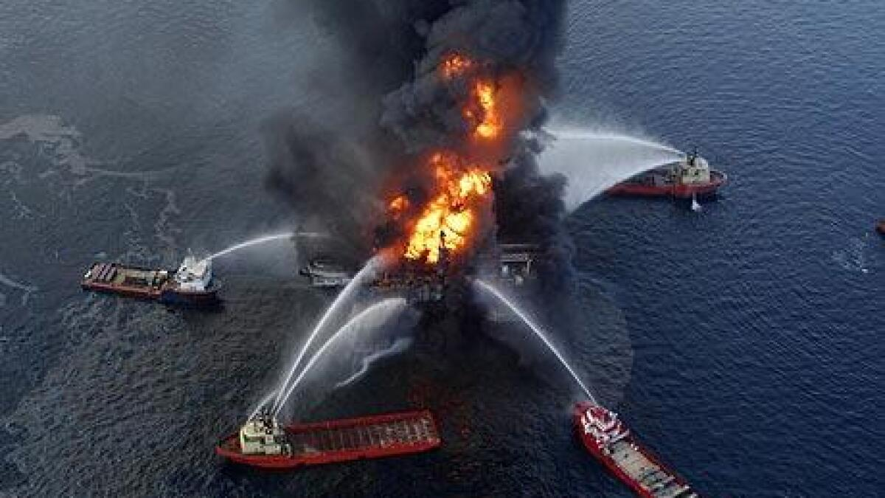
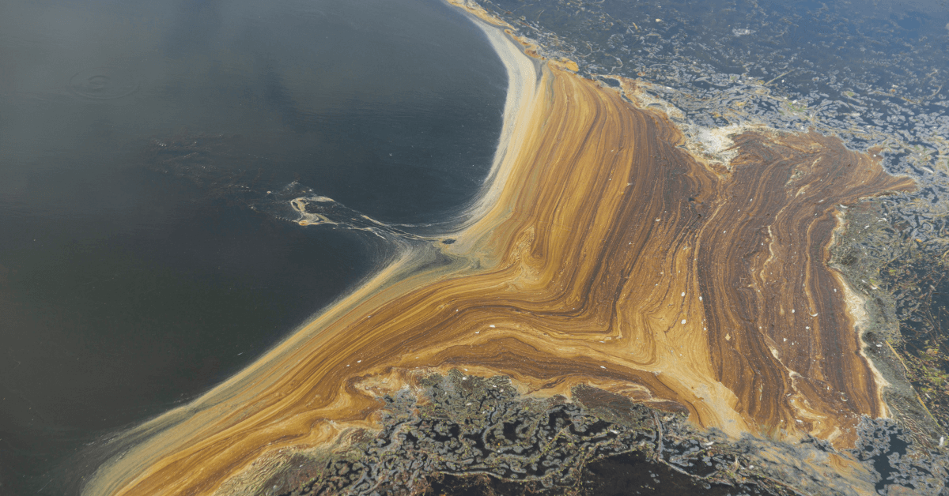
Oil Spill
Oil spills can be the result of various factors, including mistakes made by humans, natural calamities, technical issues, or intentional acts of releasing oil.
Human error accounts for an estimated 30-50% of all oil spills, while equipment failure or malfunction is responsible for around 20-40% of such incidents.
In the United States, an average of 12,000 to 15,000 oil spills are reported annually.

Slide 6
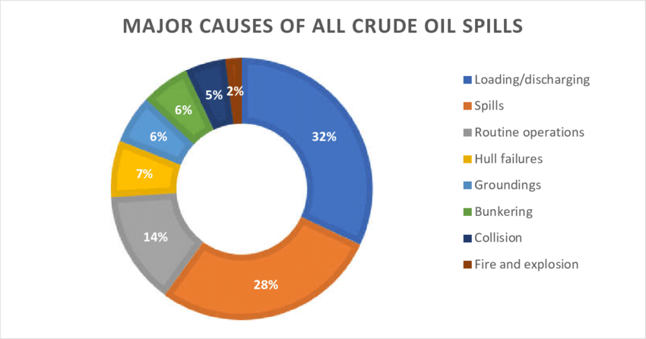
Reasons
Human error
Equipment failure
Natural disasters
Sabotage or terrorism
Illegal activities
Aging infrastructure
Lack of regulations

Slide 7
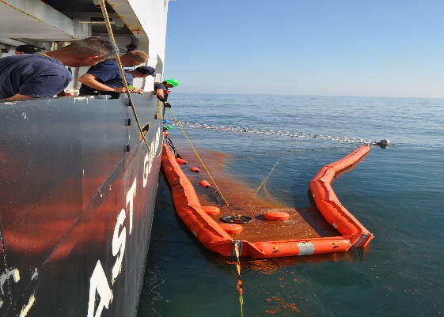
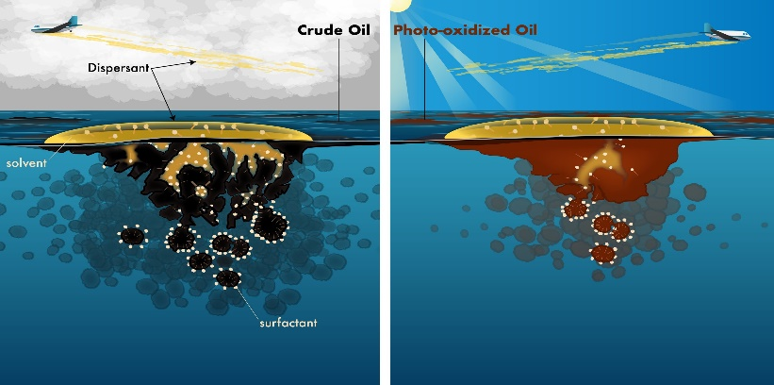
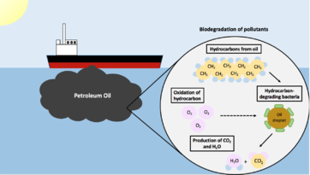
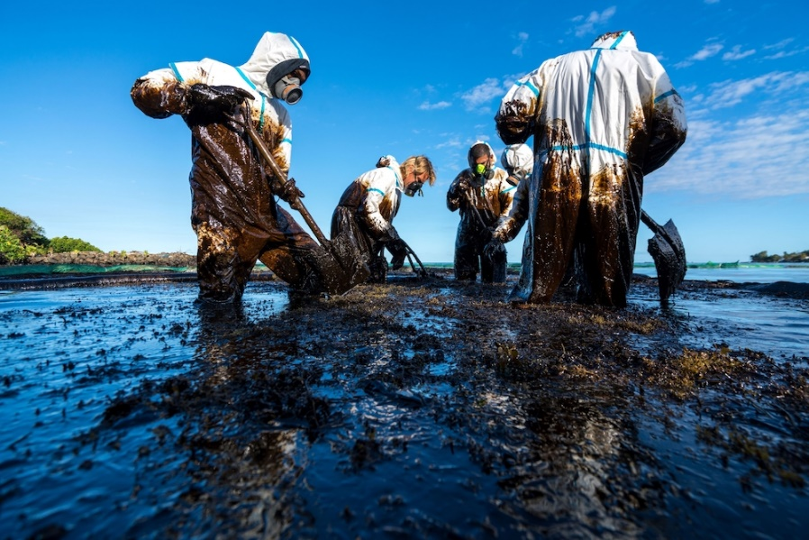
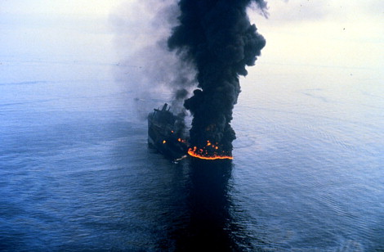
Skimming
Chemical dispersants
Bioremediation
Ways of cleaning
Manual cleaning
Controlled burns

Slide 8
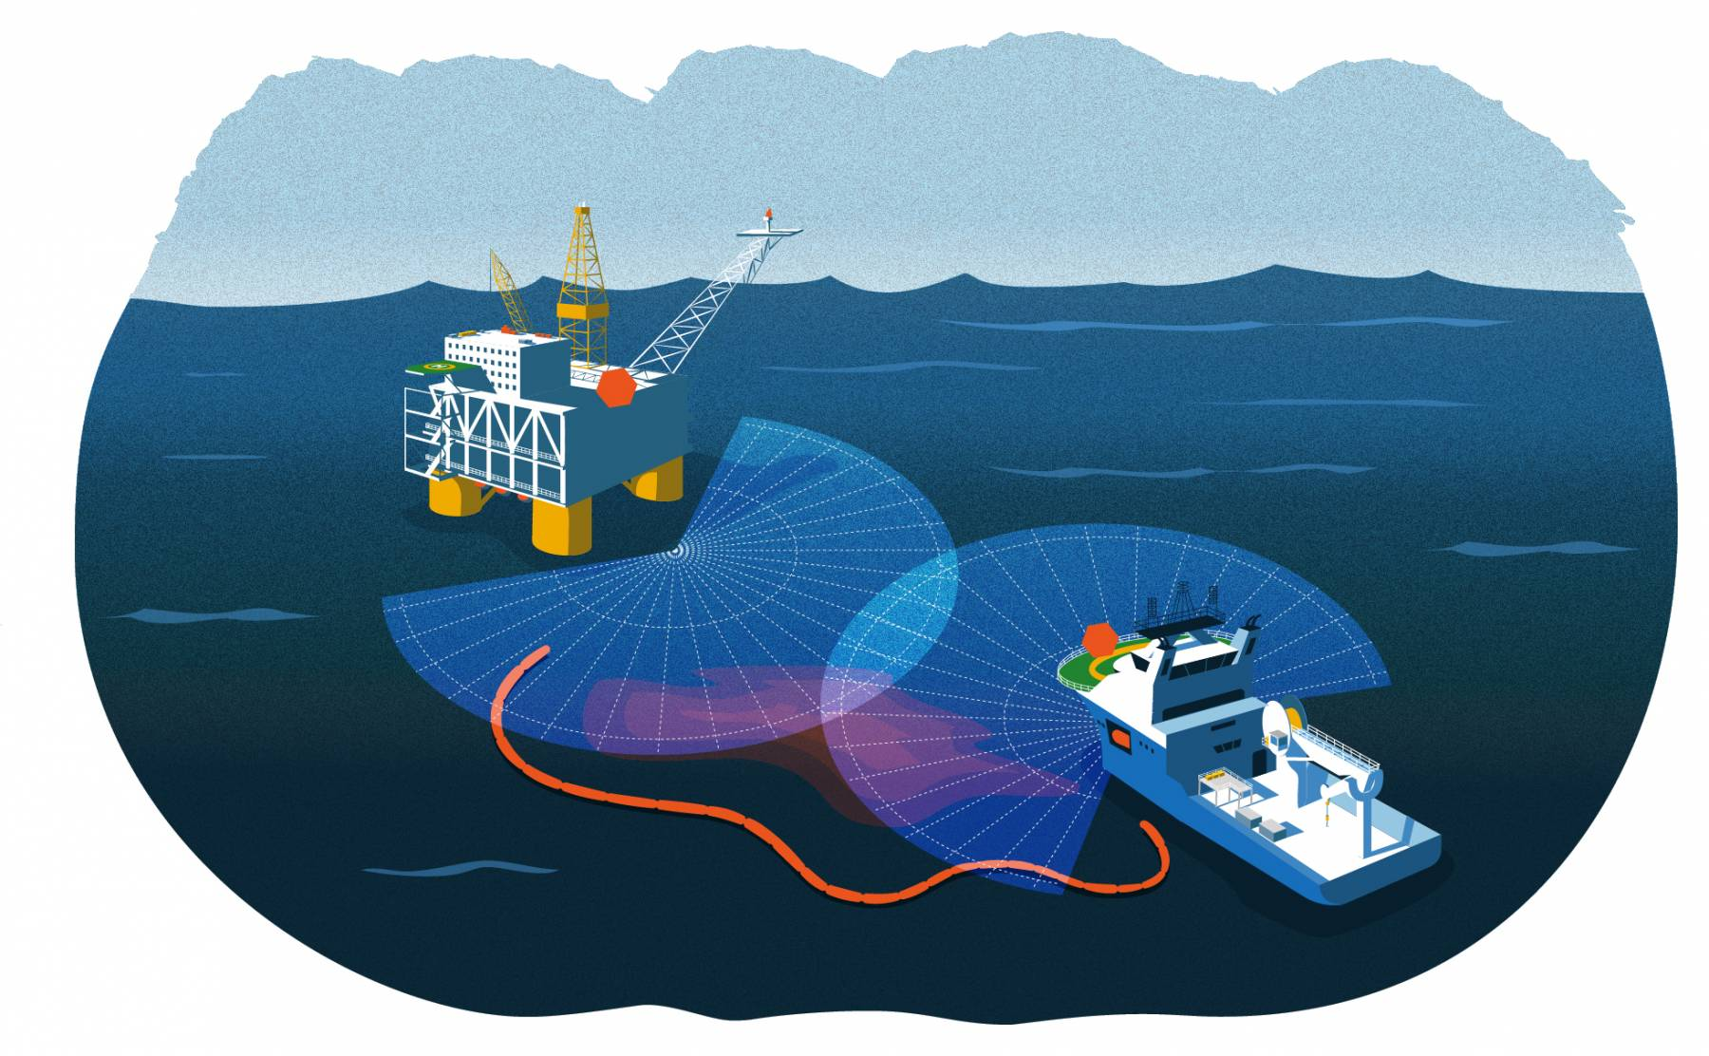
Oil Spill Early Detection
Oil spill early detection involves using technology and monitoring methods to detect oil spills as early as possible.
This can include using satellite imagery, radar, and other sensors to detect changes in the ocean's surface, as well as monitoring the movement and behavior of ships and other vessels in the area.
Early detection is critical in order to minimize the environmental impact of oil spills, and to allow for effective cleanup and containment efforts to be implemented as quickly as possible.

Slide 9
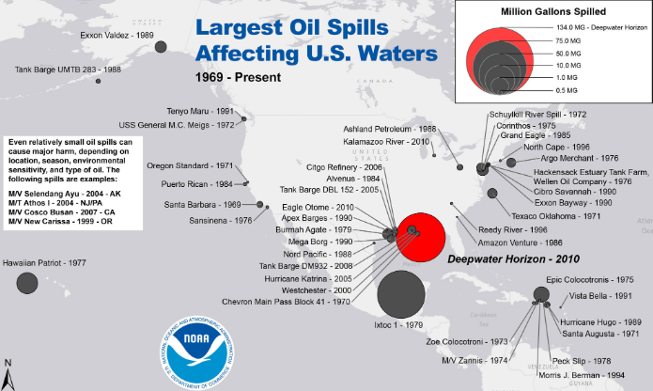
Large Oil Spills in US
The United States has experienced several significant oil spills in its history, including:
Deepwater Horizon oil spill (2010)
Exxon Valdez oil spill (1989)
Santa Barbara oil spill (1969)

Slide 10


The problem statement of an oil spill is the accidental or intentional release of oil into the environment, which can cause significant harm to ecosystems, wildlife, and local communities. Oil spills can occur during transportation, extraction, storage, or as a result of natural disasters such as hurricanes or earthquakes. The impact of oil spills can be severe, including the destruction of habitats and wildlife, contamination of water sources, and economic damage to industries such as fishing, tourism, and recreation. Responding to oil spills is a complex and challenging process, requiring coordinated efforts to contain the spill, clean up affected areas, and mitigate the environmental and economic impacts.

Slide 11
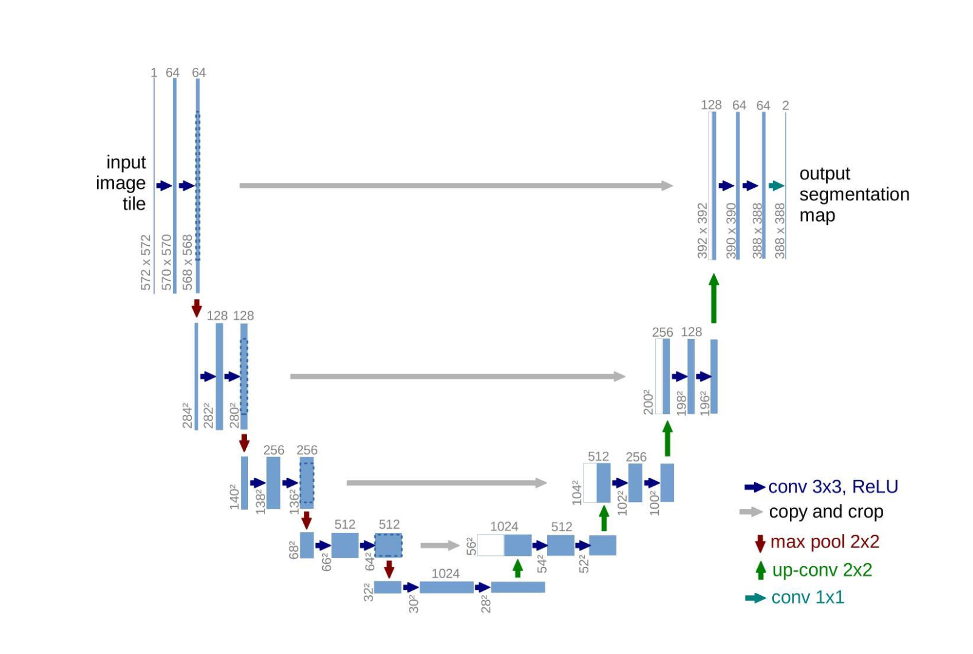
ARCHITECTURE

Slide 12
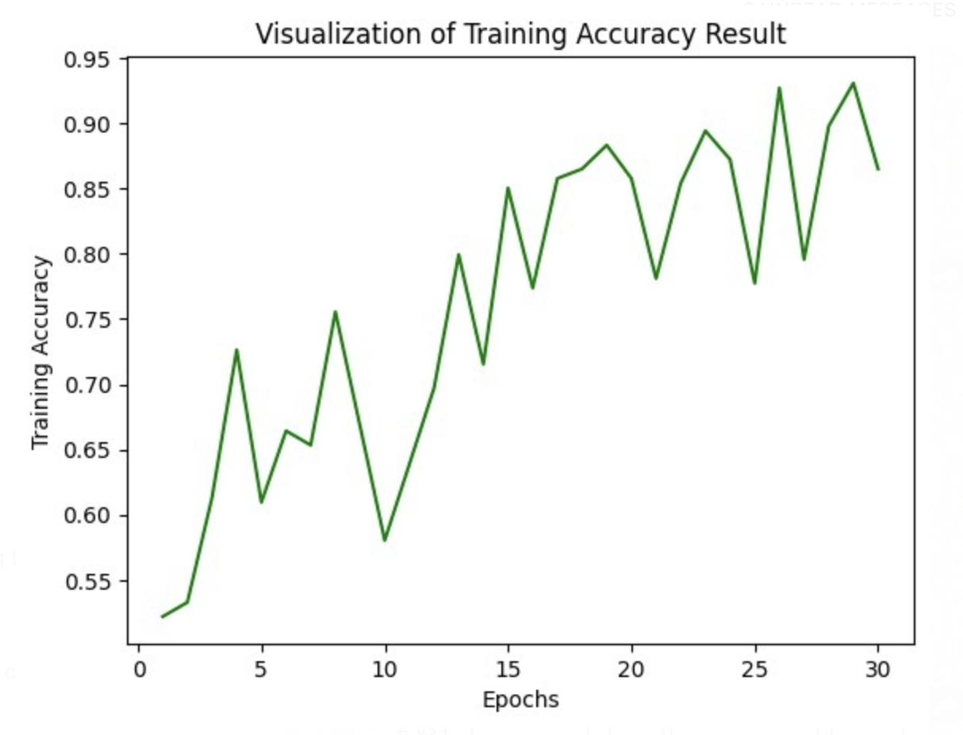
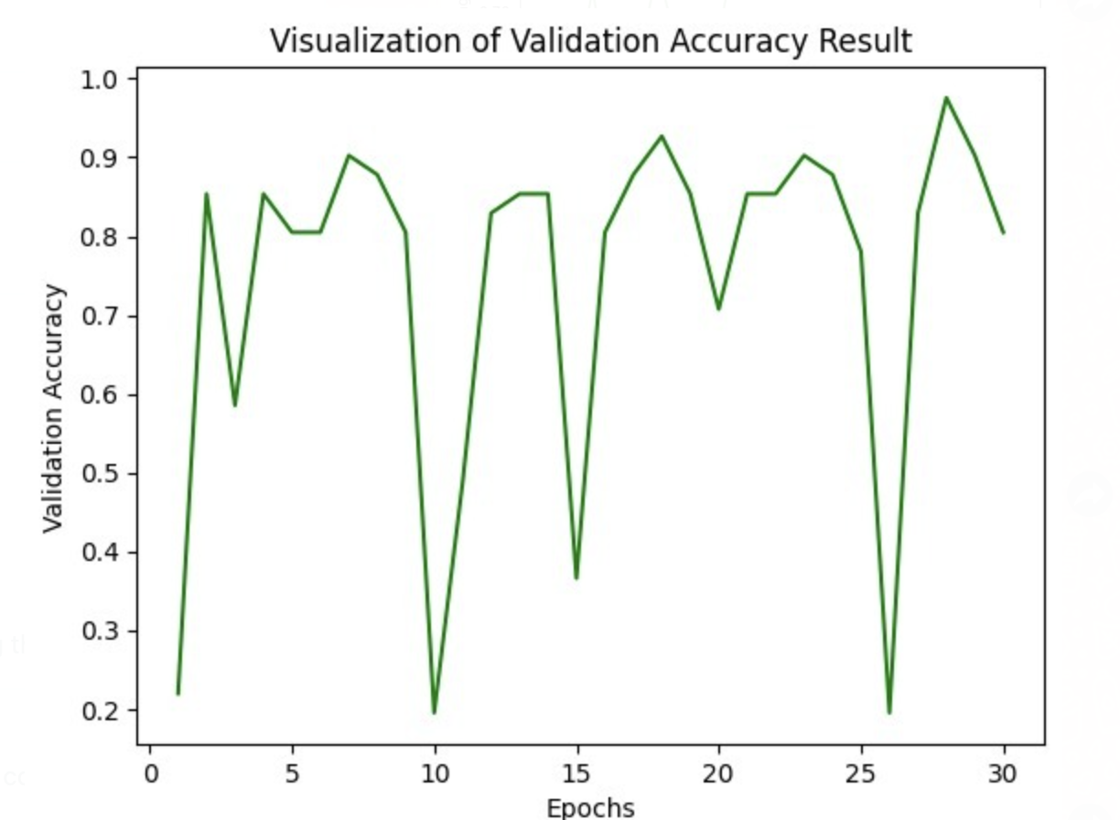
MODEL EVALUATION
Sequential CNN Results

Slide 13
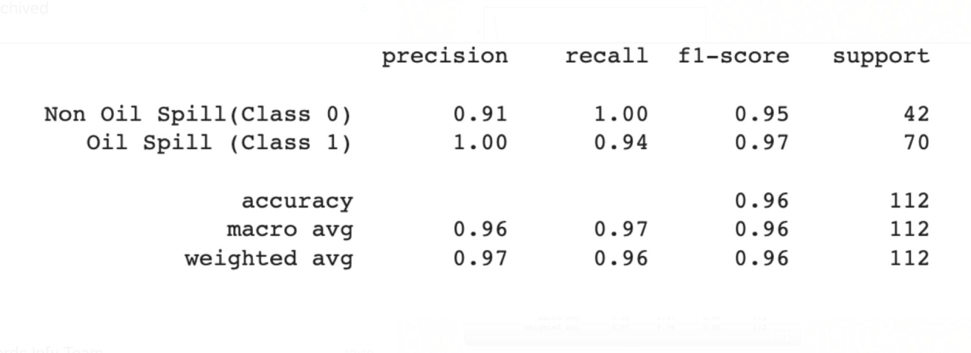
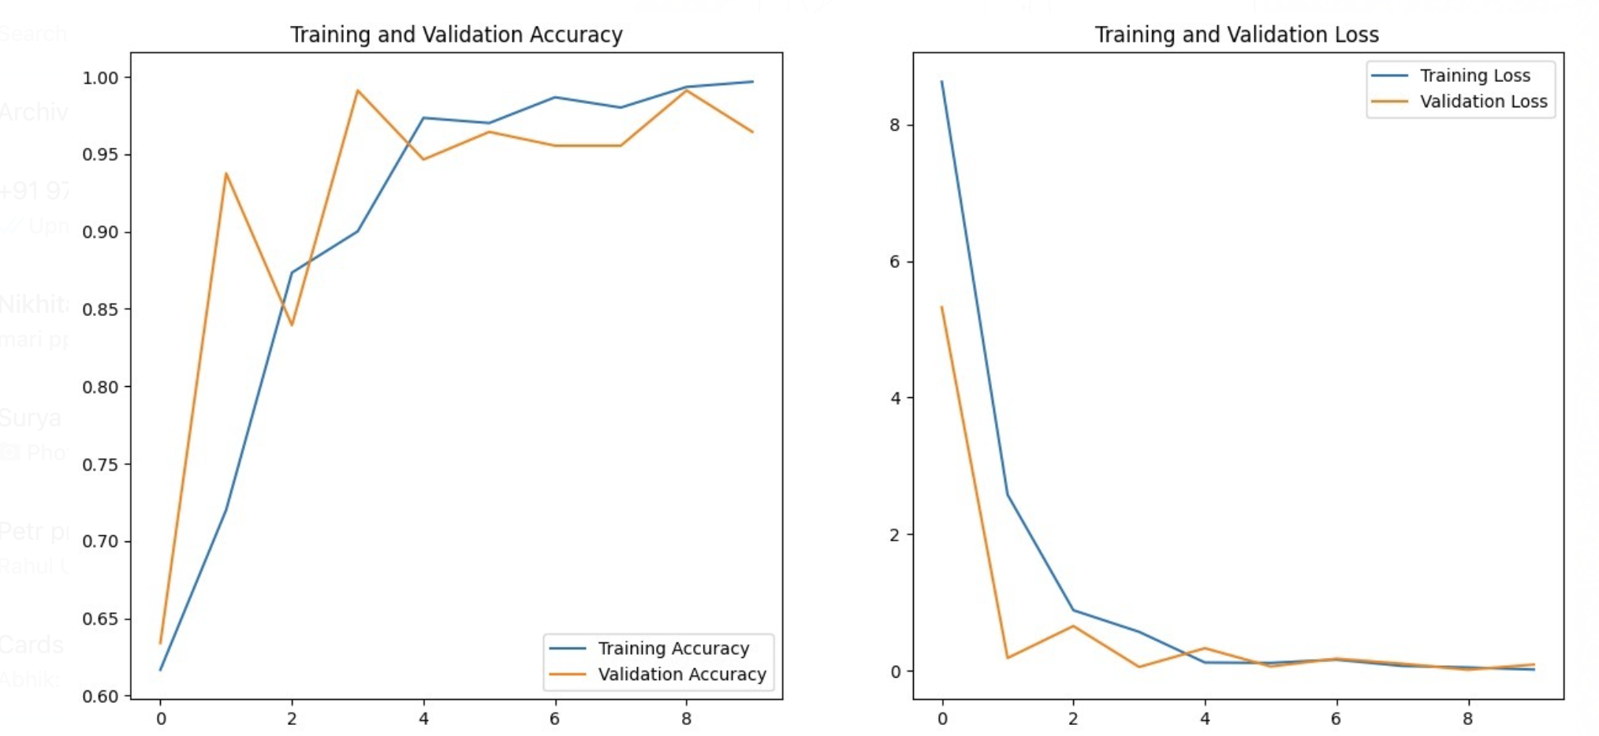
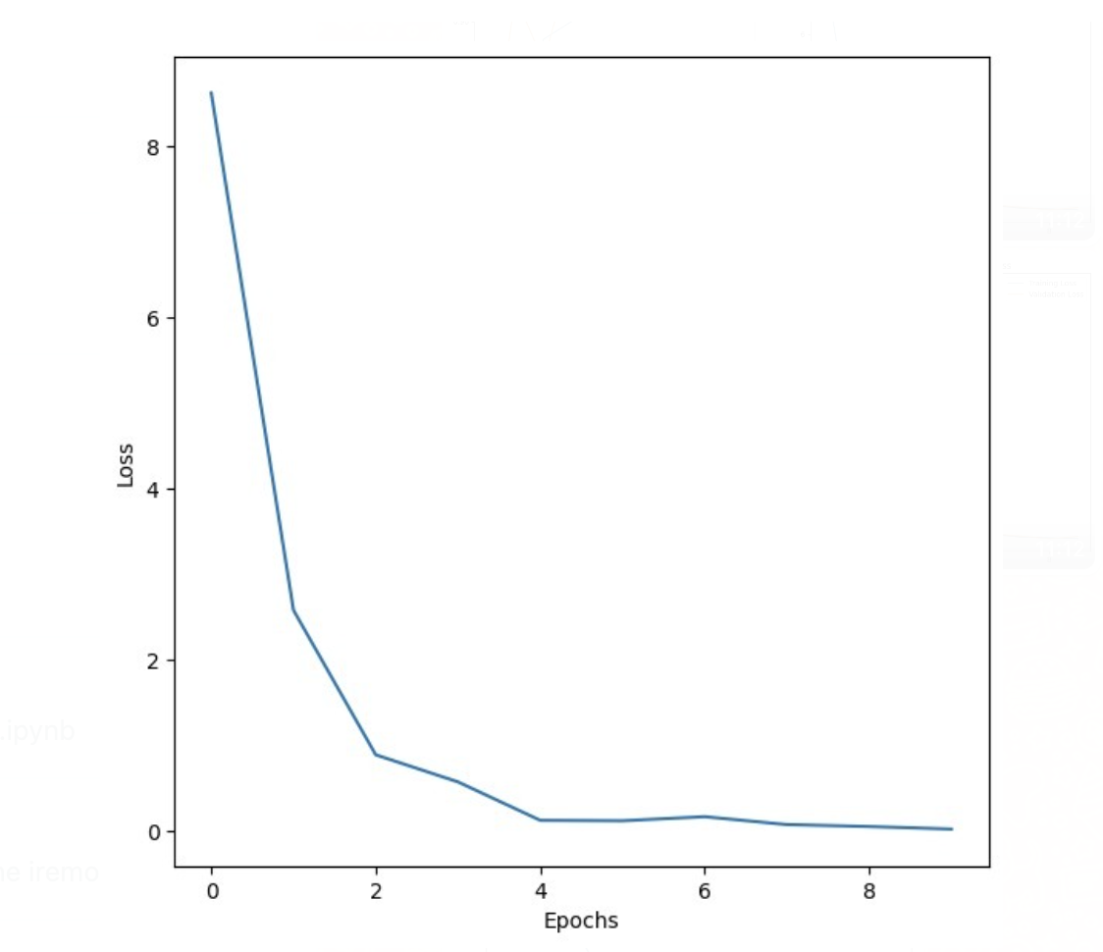
MODEL EVALUATION
Lime Model Inception Results
We were able to successfully detect oil spills by classifying images with an accuracy of 96%, with a loss of 1.79.

Slide 14
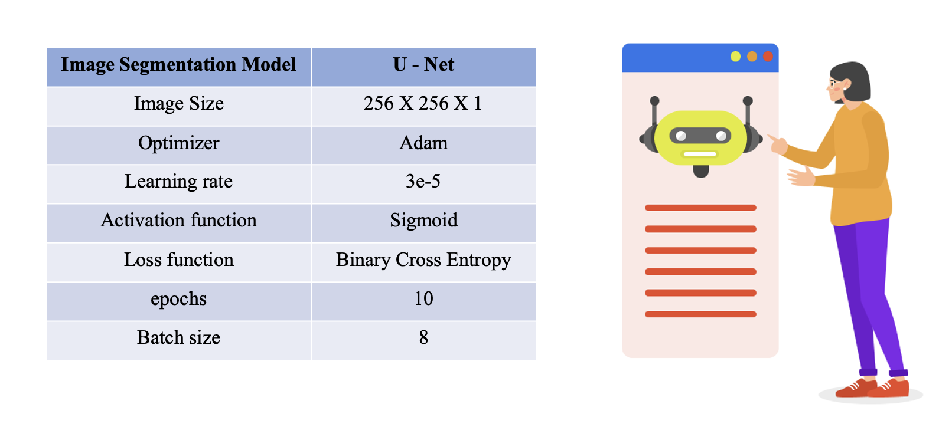
MODEL PARAMETRS

Slide 15
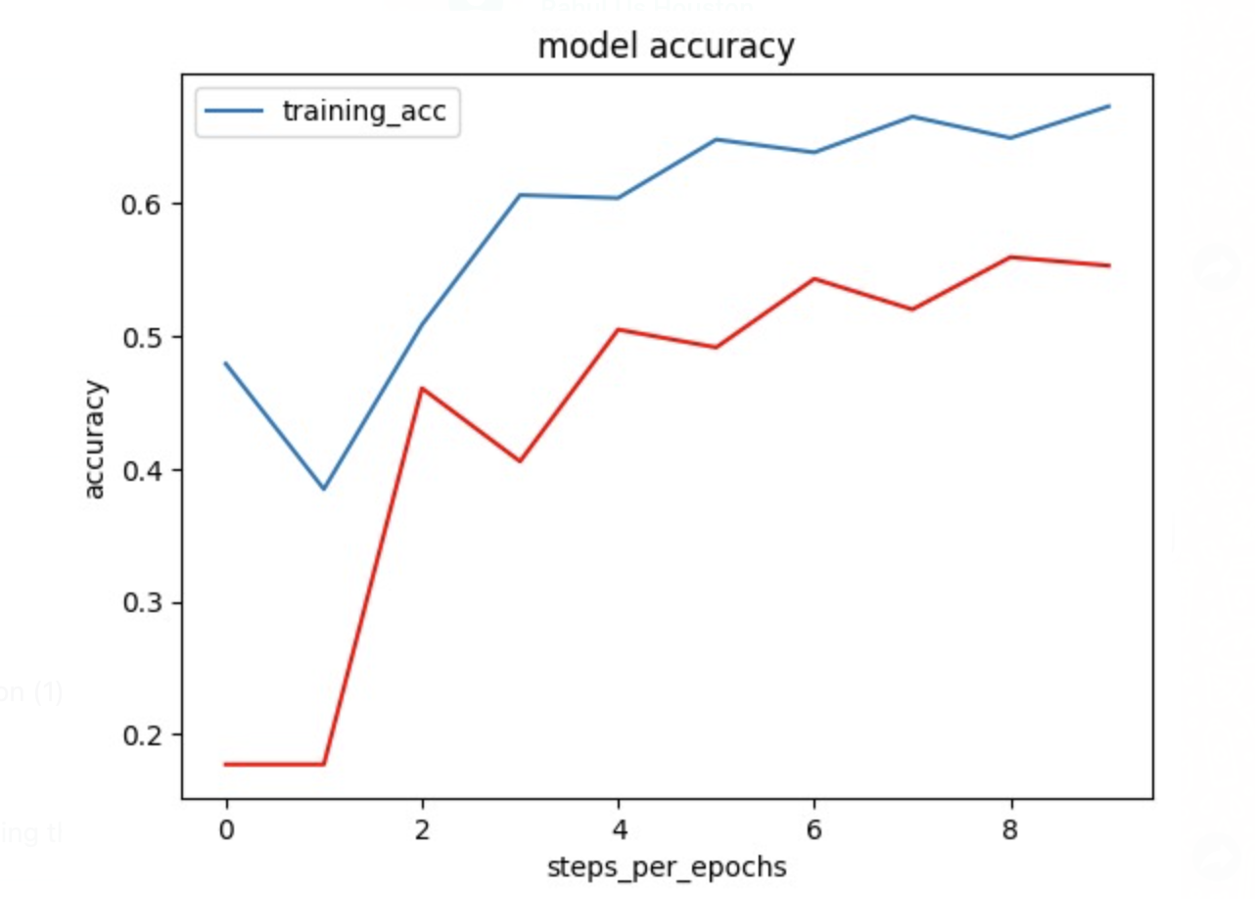
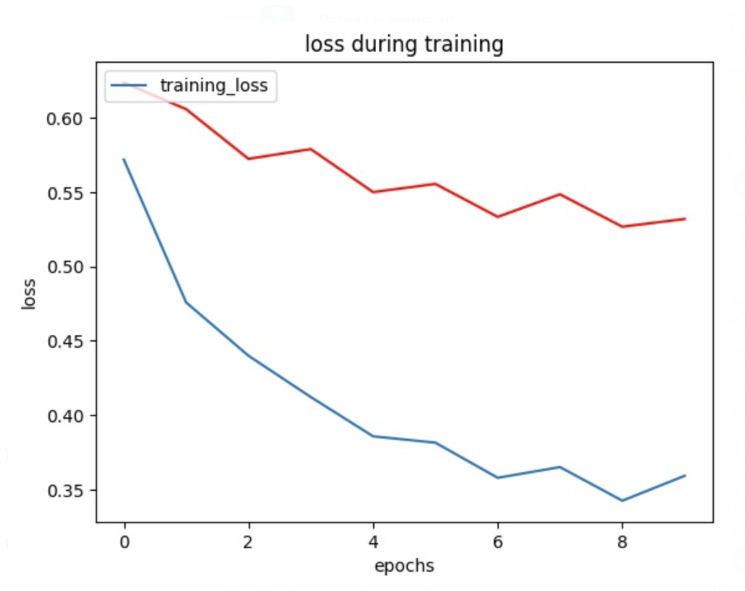
MODEL EVALUATION
U-Net Image SEGMENTATION:

Slide 16

Future Scope
Integration of unmanned underwater vehicles to capture and transmit data about oil spills that occur below the surface.
Improvement of deep learning algorithms to improve the accuracy of spill detection and reduce false positives.
Integration of real-time data from satellites and aerial imagery to improve the speed and accuracy of oil spill detection.
Expansion of the project to cover larger areas and multiple types of water bodies.
Development of a user-friendly interface to allow for easy access and analysis of oil spill data by stakeholders and decision-makers.

Slide 17


In conclusion, the development and implementation of an oil spill detection project using deep learning technology is a significant step forward in mitigating the negative impacts of oil spills. With the ability to rapidly identify the location and origin of oil spills, we can work towards controlling the spread and minimizing the economic, social, and environmental damage caused by these accidents. Through the continued development and improvement of this project, we can work towards creating a safer and more sustainable future.

Slide 18
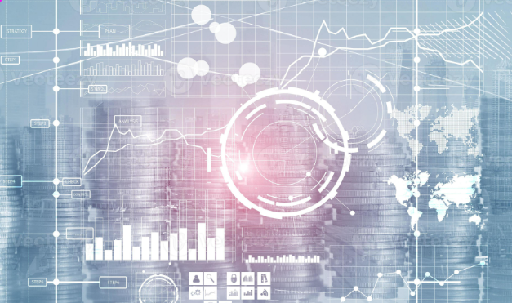
THANK YOU

